Slide 1
This PowerPoint is meant as a template for a general university presentation. Information has been researched and vetted by University Communications staff.
Remove, add, and edit content to fit your presentation's needs. Please keep font sizes, typefaces and logo placement consistent with the established format.
For questions or PowerPoint assistance, please contact Mike Becker (michael.becker@montana.edu) or Britney Patek (britney.patek@montana.edu).
Last updated: Nov. 27, 2023

Slide 2

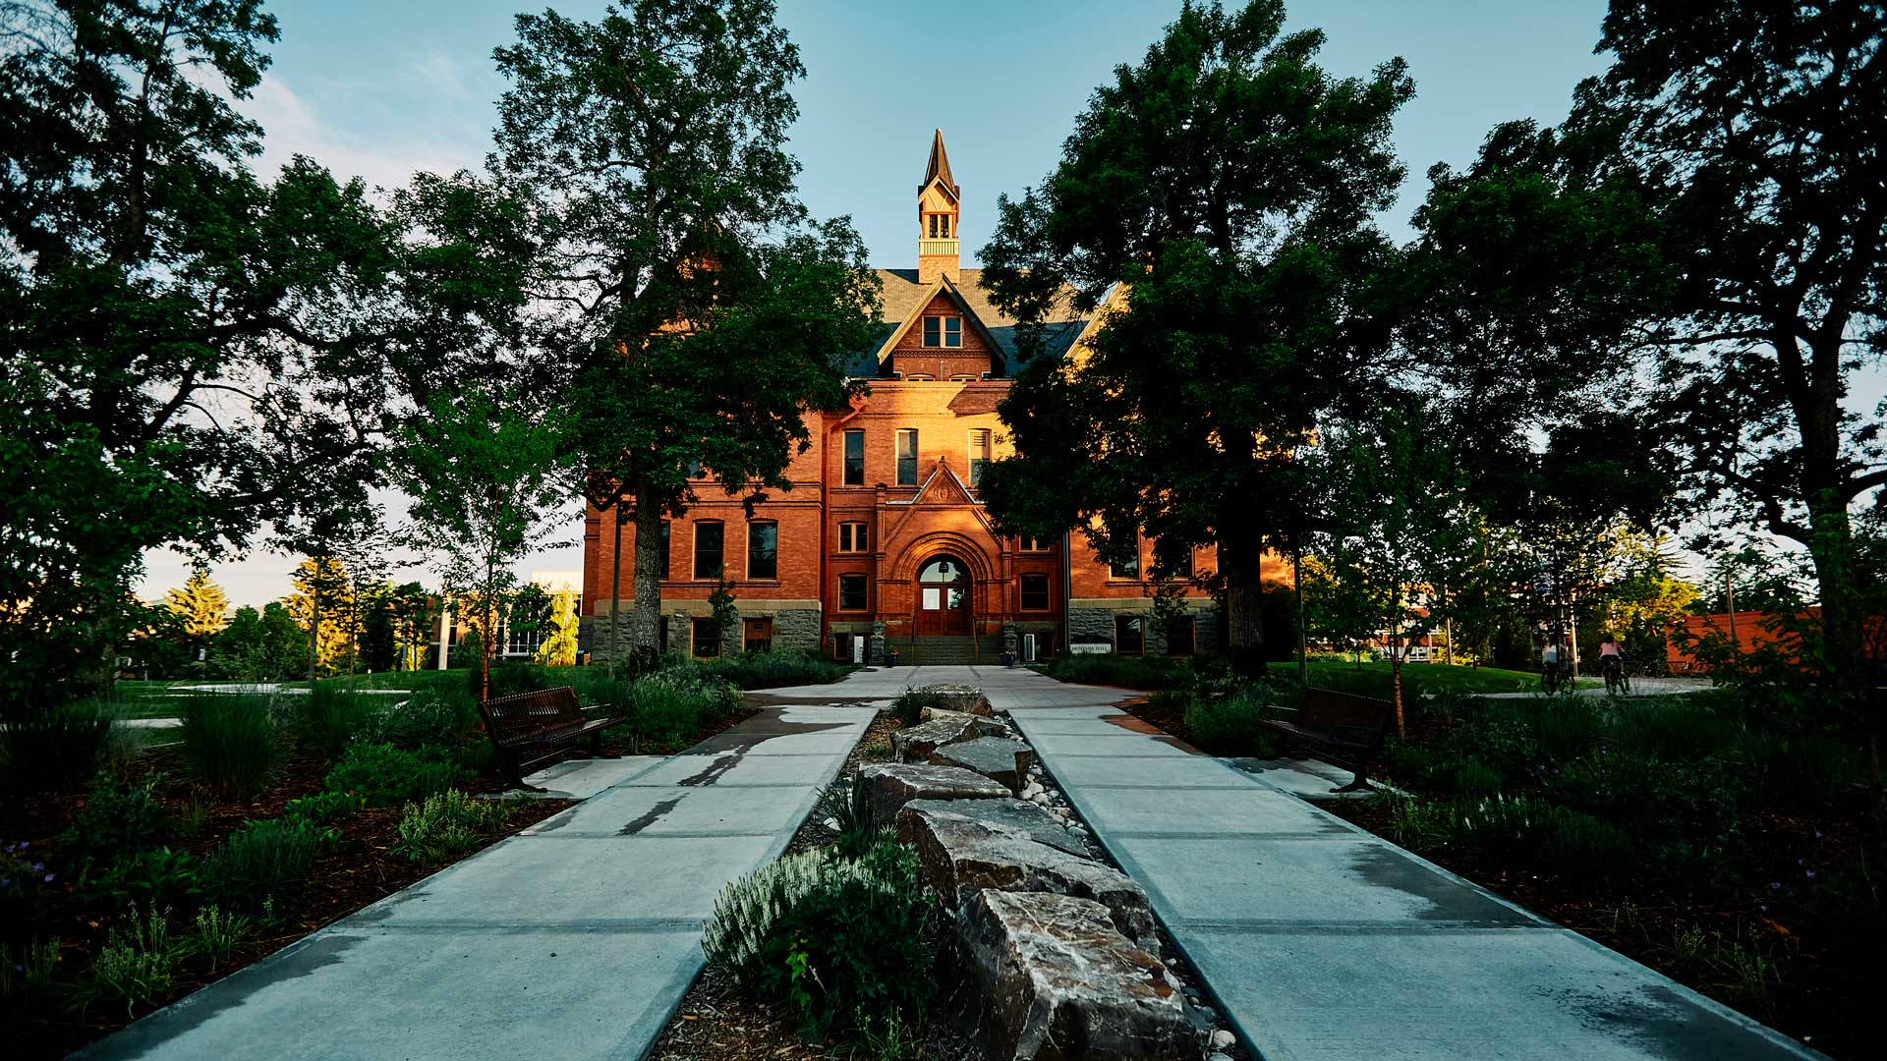
Montana State University Template
Subtitle
Month Day, Year

Slide 3

MSU Student Enrollment 2010–2023
Fall headcount enrollment has increased over 25% in last 13 years
Notes:
Not only has Fall enrollment increased by more than 25% in the past 13 years. MSU’s previous enrollment record of 16,902 in the fall of 2018 now topped by 16978. MSU’s enrollment solidifies its position as the largest university in the four-state region of Montana, Wyoming and the Dakotas.

Slide 4
Montana University System Headcount Enrollment
Source: Office of the Commissioner of Higher Education, FY2010-FY2023
Notes:
Most recent numbers available from OCHE are for FY23. MSU including the enrollment numbers from Gallatin College and University of Montana including the numbers from Missoula College.

Slide 5
Montana University System FTE Enrollment
Source: Office of the Commissioner of Higher Education, FY2010-FY2023
Notes:
Comparison of full time enrollment over the course of 13 years for all 4-year universities in Montana. Montana State University has increased its full time enrollment from 10,876 in 2010 to 14,610 in 2023.

Slide 6
MSU Full-Time Equivalent Enrollment 2010-2023
Fall FTE has grown by 34% in the last 13 years
Notes:
Fall full-time equivalent enrollment has increase from 11528 in 2010 to 15411 in 2023.

Slide 7
Freshman 15 Program
A record 81% of freshmen and 64% of all MSU undergraduates
enrolled in 15 or more credits this fall
Notes:
MSU Freshman 15 encourages students to take advantage of tuition rules to save money on their education. Students do not pay tuition for credits beyond the first 12 they take per semester, so 15 or 18 credits costs the same as 12.

Slide 8
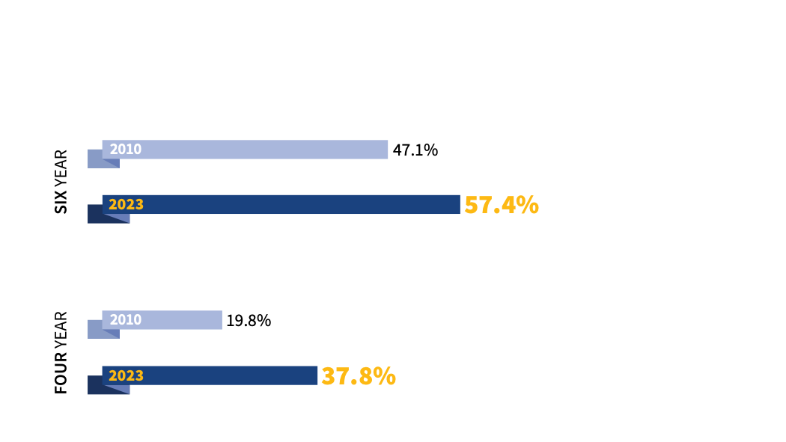
Montana State University 2019 Enrollment
MSU Graduation Rates 2010–2023
Notes:
MSU’s four-year graduation rate increased to 37.8%, and its six-year rate, which is tracked by the federal government, increased to 57.4%. The university awarded 3,503 degrees in the past year, the second highest total on record.

Slide 9
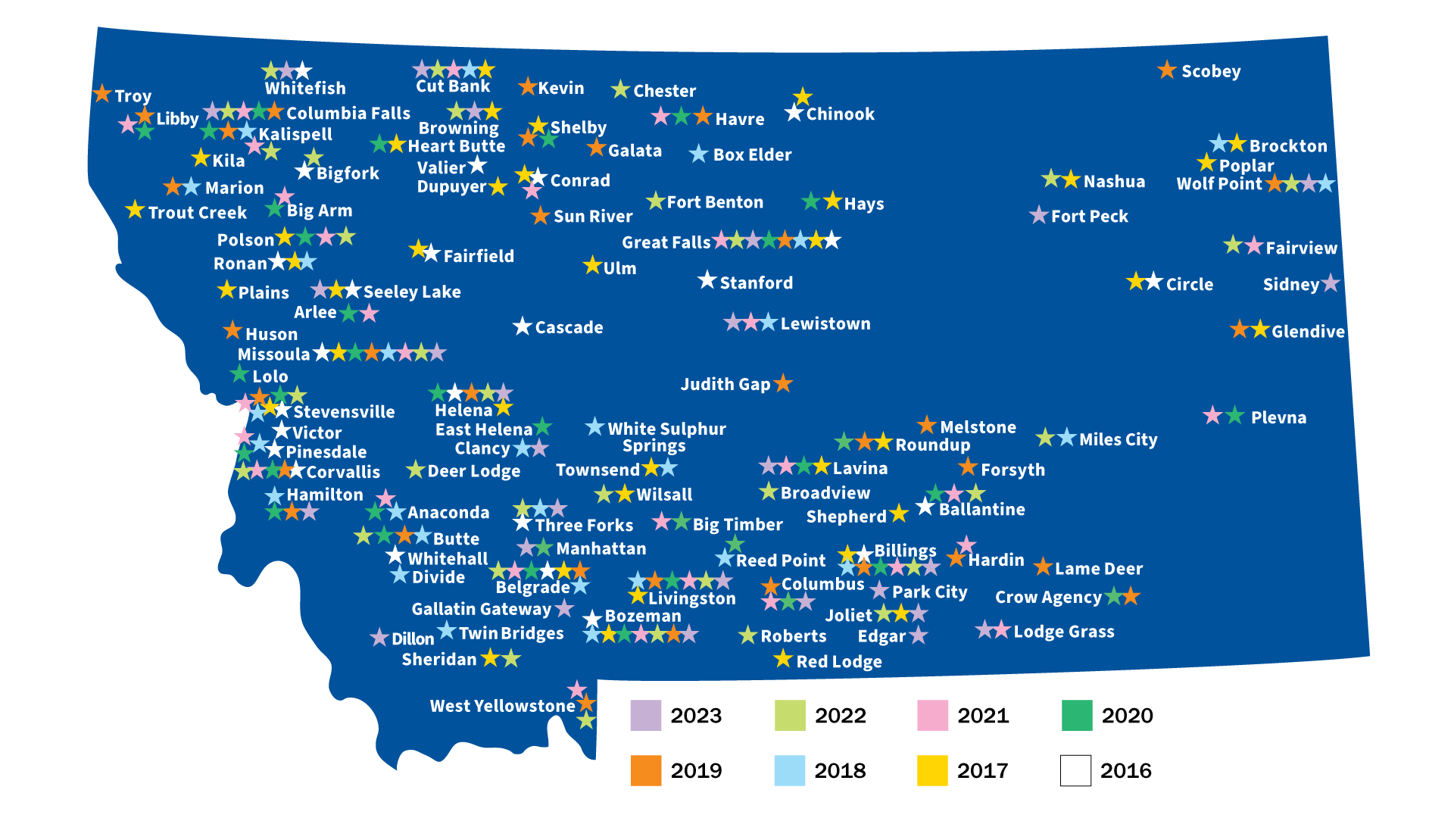
Hilleman Scholars come from all across the state
Notes:
A look at the towns from across the state that have produced Hilleman Scholars. The MSU Hilleman Scholars Program, which started in 2016, is a leadership program designed just for Montana residents who demonstrate significant academic, leadership, and career potential just as Maurice Hilleman had for the life-saving contributions he made through his efforts in vaccine science.

Slide 10
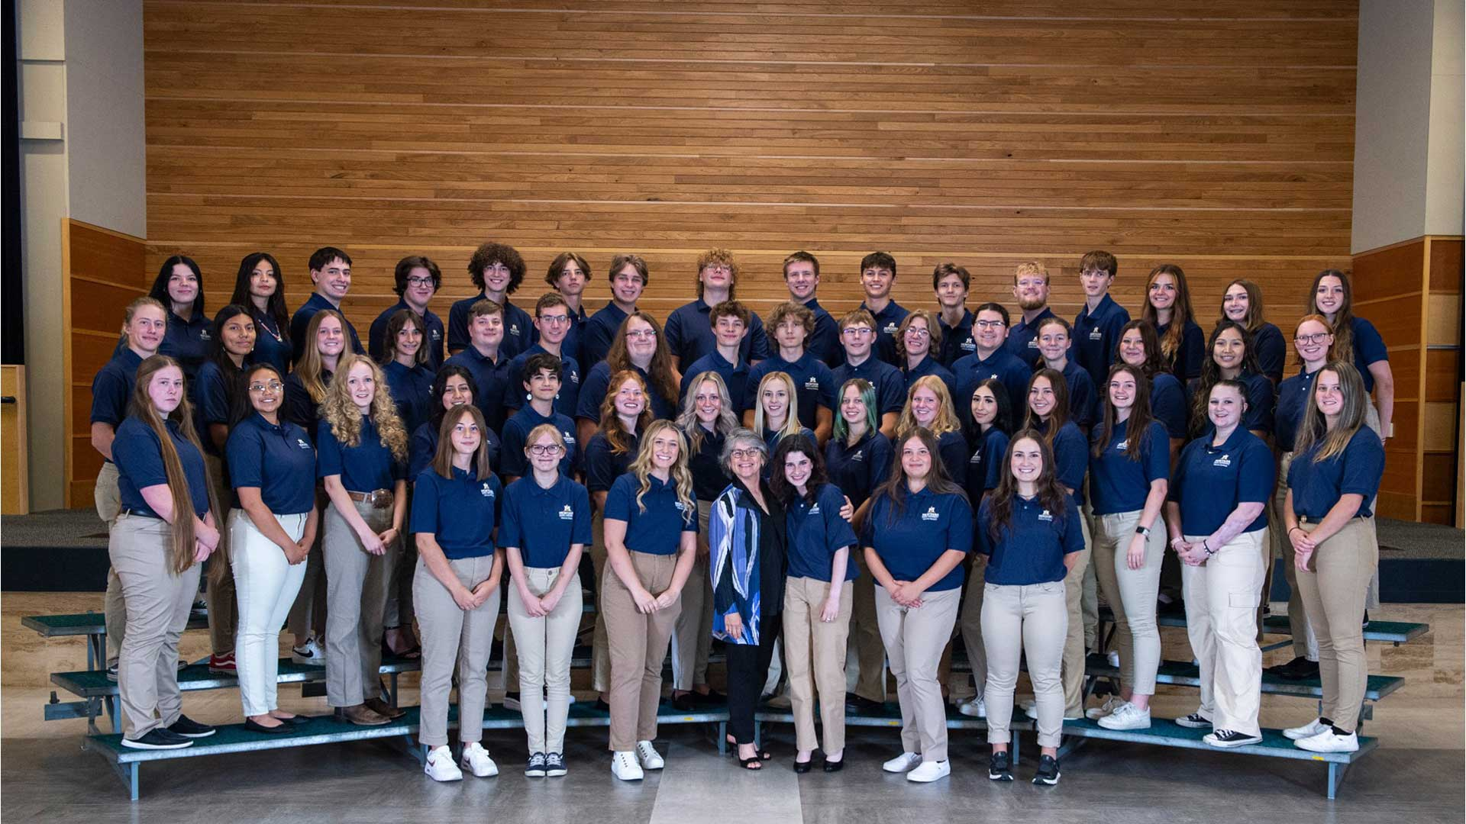

Montana State announces 8th class of Hilleman Scholars
Awards
Notes:
53 high school graduates have been selected to be a part of the Hilleman Scholars Program in 2023. MSU Hilleman Scholars receive the privilege of networks, mentors, and investors who are working with them to help advance a better future for not just themselves, but for Montana, our nation, and world.

Slide 11
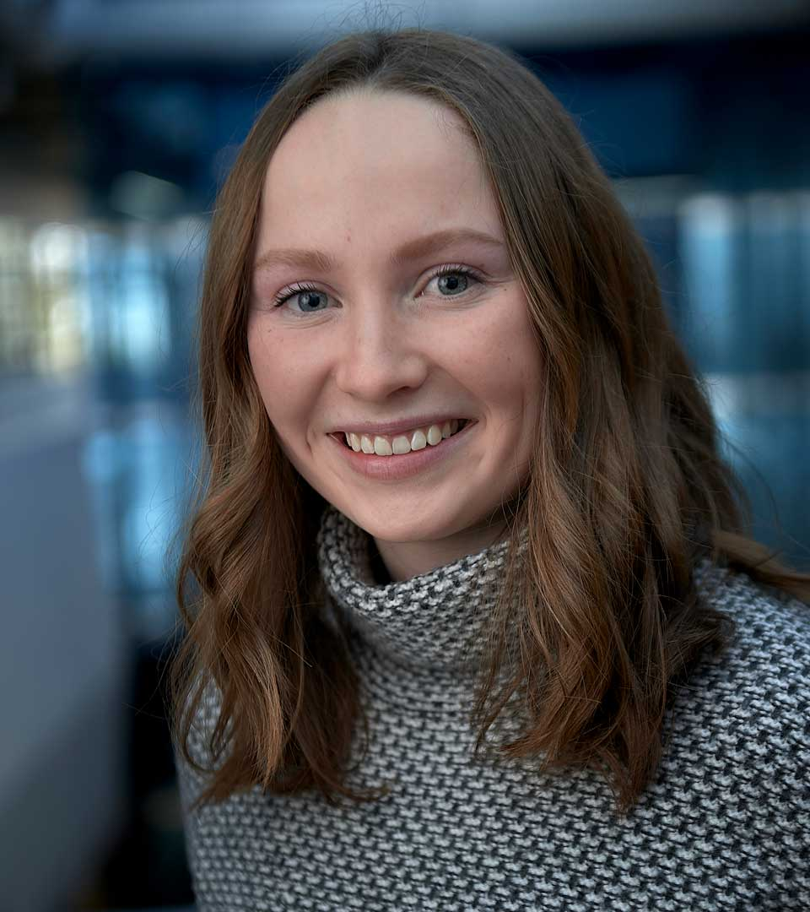
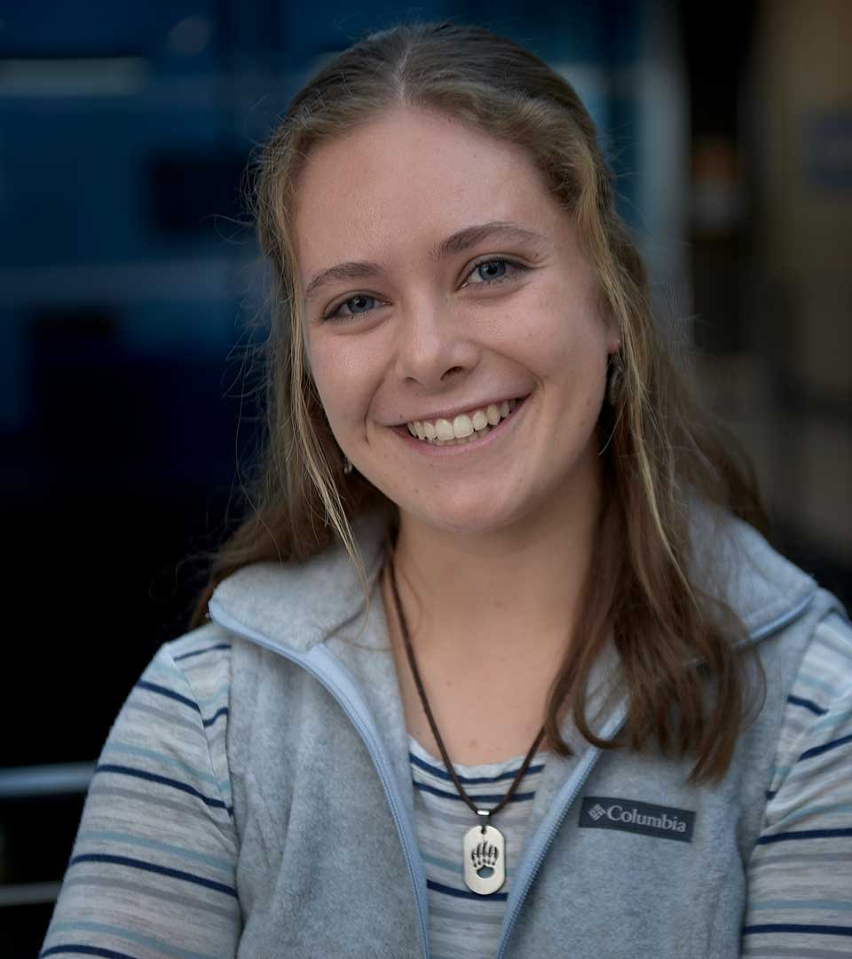
Ava Graham and Madison Torrey win prestigious Goldwater scholarships
Awards
Notes:
Ava Graham, a junior majoring in biochemistry and microbiology from Red Lodge, and Madison Torrey, a junior majoring in environmental engineering from Fort Collins, Colorado, are MSU’s two newest winners of the scholarship given by the Barry Goldwater Scholarship and Excellence in Education Foundation. The Barry Goldwater Scholarship is the nation's premier scholarship for undergraduate students pursuing a research career in the natural sciences, mathematics, and engineering.

Slide 12
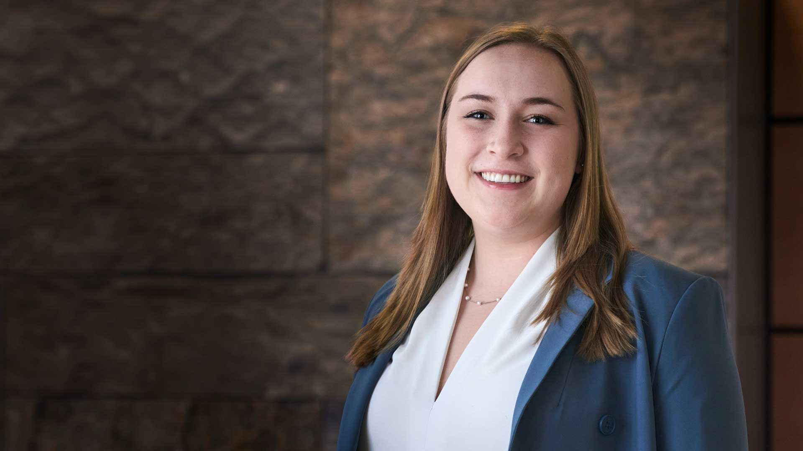
Andee Baker receives Truman Scholarship, recognizing leadership, community involvement and academic achievement
Awards
Notes:
The Truman Scholarship program was established by Congress in 1975 in the memory of President Harry Truman to support and inspire the next generation of public service leaders. Andee Baker is the 13th Truman Scholar to come from MSU, recognized for her leadership roles in both 4-H and FFA and her commitment to help agriculturalists of all ages access resources and live more fulfilled lives by advocating for better mental health resources.

Slide 13


Suicide prevention at MSU
News
Notes:
The MSU community is committed to creating a culture of support, which means that we acknowledge the different ways that students might encounter difficulty, reach out to provide support, and encourage getting help at one of the many agencies on campus that offer counseling or student support services. MSU has a team of psychologists, counselors, faculty, staff, and student leaders working to protect the MSU community from the devastating impact of suicide.

Slide 14
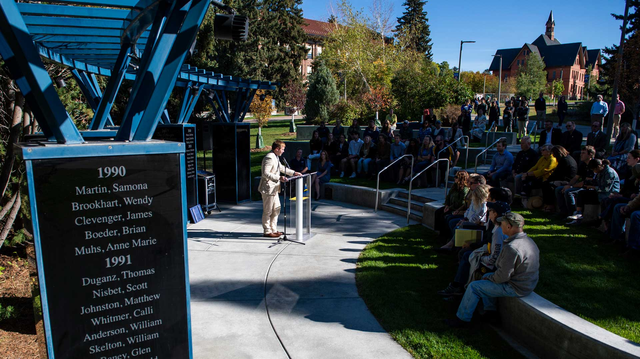
Renovated student memorial opened
Student leadership key to making the outdoor space more visible and accessible
News
Notes:
The outdoor space, which displays names dating to 1990, is located just off the west entrance of the Centennial Mall near the Duck Pond. As part of its redesign and renovation, the student memorial and the names of the students it honors are now more visible, and the site includes outdoor seating, new trees and landscaping. In 2016, MSU’s student government decided to research and review options to find “the best possible ways to honor the students who have passed away as well as their parents,” and in 2019, ASMSU voted to commit $75,000 to update the student memorial, and in 2020, project organizers participated in MSU Giving Day, a 29-hour online fundraising event, and drew more than 150 donors.

Slide 15
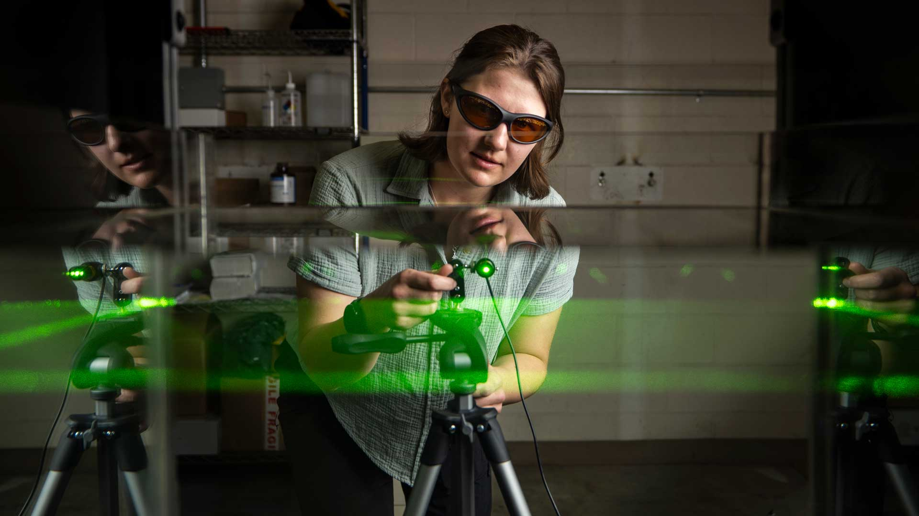
MSU annual research expenditures
hit new record of $230 million
Research
Notes:
For a fifth straight year, Montana State University recorded an all-time high for research expenditures — the funding put toward scientific discovery and other scholastic and creative pursuits. MSU is the largest research enterprise in the state, and its total expenditures exceed the research expenditures of all other institutions in the state combined.

Slide 16
MSU Annual Research Expenditures
Notes:
Montana State research expenditures top $200 million for first time.
The vast majority of dollars spent on MSU research come from federal grants and are won through competitive applications. Roughly 90%, or about $207 million, came from federal sources including the Department of Defense, NSF, NASA and the Department of Health and Human Services. Most of the remaining 10% is from private foundations and donors, with 2% coming from the state of Montana.

Slide 17
MSU Annual Research Expenditures - 2023
College of Agriculture
$49.8 million
College of Arts & Architecture
$140.5 thousand
Jake Jabs College of Business
& Entrepreneurship
$33.9 thousand
College of Education, Health
and Human Development
$6.2 million
Norm Asbjornson College of Engineering
$23.2 million
College of Letters and Science
$28.6 million
Mark & Robyn Jones College of Nursing
$13.9 million
Notes:
Among MSU’s academic colleges, the College of Agriculture recorded the largest figure at almost $50 million, followed by the College of Letters and Science at almost $29 million. MSU's Norm Asbjornson College of Engineering had over $23 million in expenditures, while the Mark and Robyn Jones College of Nursing had a total of about $14 million and the College of Education, Health and Human Development had over $6 million. MilTech at MSU recorded the largest figure of any university program, at $35 million.

Slide 18

Montana State plant scientist honored with regional teaching award
Awards
Notes:
Jennifer Lachowiec received the New Teacher Award of Excellence from the Western Academic Program Section, or W-APS, at the Joint Western Directors summer meeting in Richland, Washington, on June 22. The western region includes Alaska, Arizona, California, Colorado, Idaho, Hawaii, Montana, Nevada, New Mexico, Oregon, Utah, Washington and Wyoming.

Slide 19

College of Agriculture receives public and private support to develop precision agriculture program
College of Agriculture
Notes:
A strong justification used by U.S. Congress for enacting the Precision Ag Connectivity Act of 2018 was an estimated 40% increase in agricultural productivity nationally through the development and adoption of precision agriculture technologies. MSU precision agriculture program that is interdisciplinary and offers opportunities not just to students but also to faculty, staff and Montana producers. If everyone involved can have a well-rounded idea of how precision agriculture can aid various areas — from plant breeding to livestock management, data analysis to gene editing and sustainability — then the state’s farming industry can only benefit.

Slide 20

MSU's top college for research expenditures
Research areas include infectious diseases, microbes in Yellowstone National Park, invasive plant species, soil science and water resources
College of Agriculture
Notes:
These research expenditures will allow the College to meet it's Focus area goal of advancing innovative research to enhance local and global impact.

Slide 21
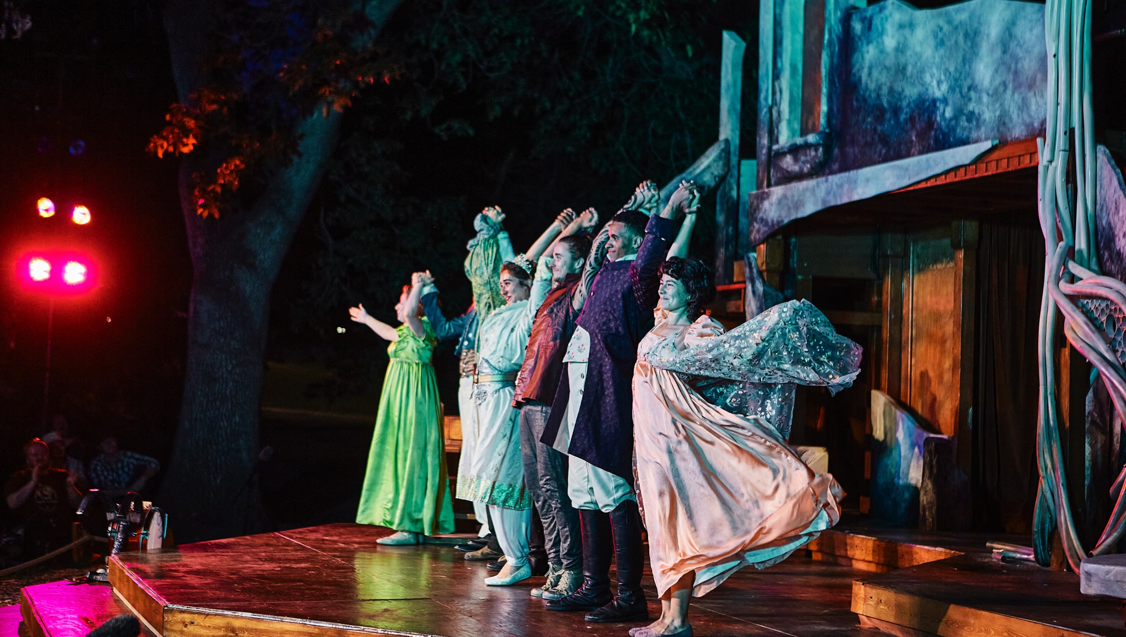
Outreach projects include
Shakespeare in the Parks
Music ensemble tours
Remote studio and design/build projects in Montana, the U.S. and abroad
College of Arts &
Architecture
Notes:
Known for their professional Shakespearean touring company, SIP has been performing each summer all over Montana, Wyoming and southern Idaho since 1973. Free to the community, donations and grants provide funding.
MSU's performing ensembles offer a wide array of opportunities for musicians to practice and perform their art.
Architecture programs that provide students the experience of integrated design projects from concept to completion. Examples: On-going relationship with Yellowstone Park to examine the built environment of the Park. Two international projects include a Sherpa climbing school in Nepal and a new project examining slums in Nairobi.

Slide 22

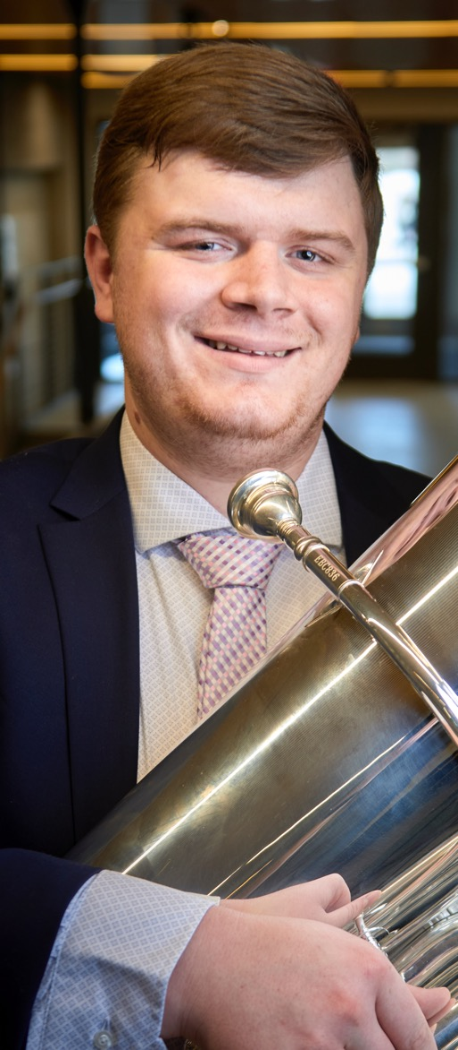


College of Arts & Architecture Award Winners
College of Arts & Architecture
Hayden Painter
Berkeley Prize
Jake Kittleson
Music Teachers National Association Competition
Julie Gosswiller
Teacher of the Year
Josh DeWeese
Governor’s Art Award
Notes:
The Berkeley Prize is a prestigious award given to the winner of an international architecture essay competition hosted by the University of California, Berkeley. Hayden won $9,000 for his work in finding ways to create spaces for older generations to remain integrated in society.
Tuba player Jake Kittleson won 3rd place in the Young Artist's Brass Competition
MSMTA Teacher of the Year award recognizes exceptional dedication to the teaching profession, service to colleagues and students, teacher leadership, and dedication to the advancement of music. Gosswiller was selected because her focus on teaching and collaborative performance has made a “vast impact” on the Montana music community.
The Governor’s Arts Awards, presented in the Governor’s name and administered by the Montana Arts Council, recognize outstanding Montana citizens and organizations whose exemplary achievements in the arts, or on behalf of the arts, benefit all Montanans. Multiple recommendation letters talked of his commitment to helping other ceramics artists, including inviting younger potters to work in his studio and participate in his firings.

Slide 23

Jabs is thriving
Enrollment soared ~40% in the last 4 years, attracting high-quality students with outstanding employment prospects and empowering new programs and opportunities
Jake Jabs College of Business and Entrepreneurship
Notes:
Jake Jabs is the has the third largest college enrollment with a total headcount of 2,186 in 2023.

Slide 24

Jabs Students Contend Nationally
American Indigenous Business Leaders - 2nd place at national competition
American Marketing Association - Top 10 chapter worldwide
Entrepreneurship & Innovation prizes totaling $100k+
Jake Jabs College of Business
and Entrepreneurship
Notes:
The MSU branch of American Indigenous Business Leaders, housed in the Jake Jabs College of Business and Entrepreneurship, sent a contingent to the national AIBL conference in July in California. The group included students Bruno Amon Franceschi, Blythe Gill, Terrance Limpy, Sierra Real Bird, Lana Redfield and Naomi Redfield, along with associate professor Virginia Bratton, one of the club’s faculty advisers.
The Montana State University student chapter of the American Marketing Association once again earned a Top 10 designation out of more than 330 chapters at the annual AMA International Collegiate Conference, which took place March 30 to April 1 in New Orleans.

Slide 25
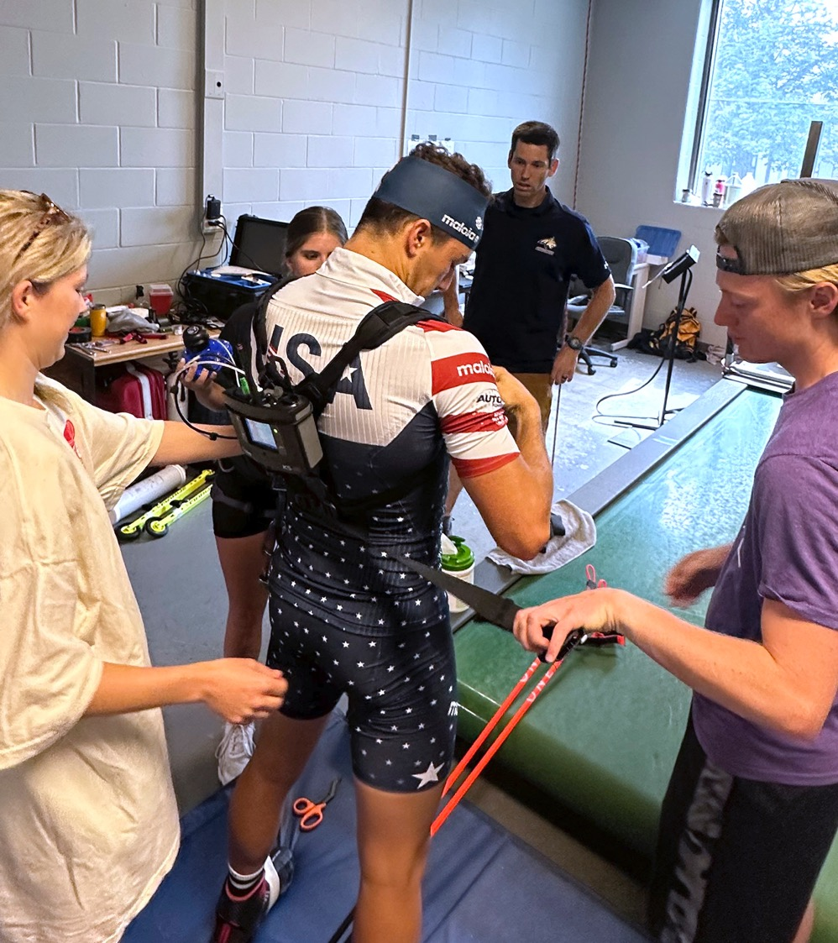
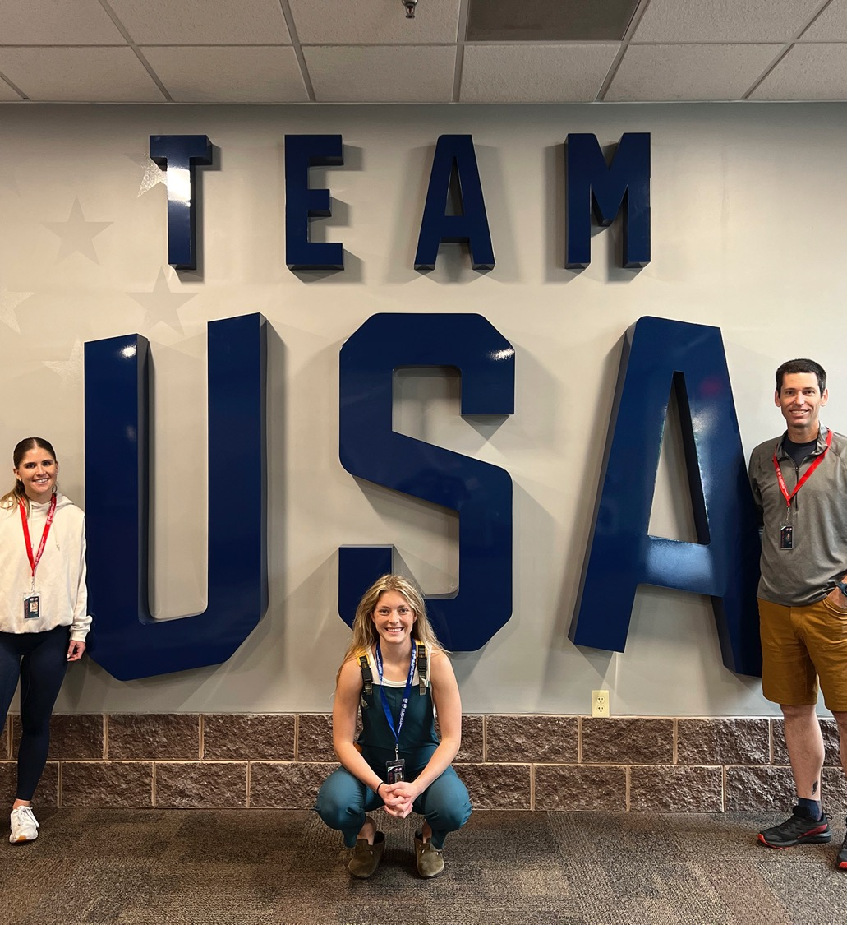
James Becker and students aid U.S. Biathlon
MSU team conducts physiologic and biomechanical assessments with national team athletes in Lake Placid
MSU College of Education, Health and Human Development
Notes:
Three students – graduate student Ashlyn Baird and undergraduates Tim Cobb and Riley Hagger – traveled to Lake Placid, New York, along with MSU associate professor James Becker from the MSU Department of Food Systems, Nutrition, and Kinesiology, to conduct tests assessing both the physiology and ski technique of 12 biathletes on the U.S. national team. The group also conducted tests on three athletes from Project X, the national team’s development group. The testing took place at the U.S. Olympic and Paralympic Training Center over four days during a training camp.

Slide 26

Montana State University and partners receive $4.1 million for 5-year project to train counselors for work in rural Montana
College of Education, Health and Human Development
Notes:
The grant, from the U.S. Department of Education, will be used for the Rural Mental Health Preparation Practice Pathway Partnership, which also aims to increase the diversity, training, employment, retention and effectiveness of mental health service professionals in rural, remote and tribal communities in Montana. The project expands on a previous and similar grant-funded project MSU and its partners began in 2019.

Slide 27
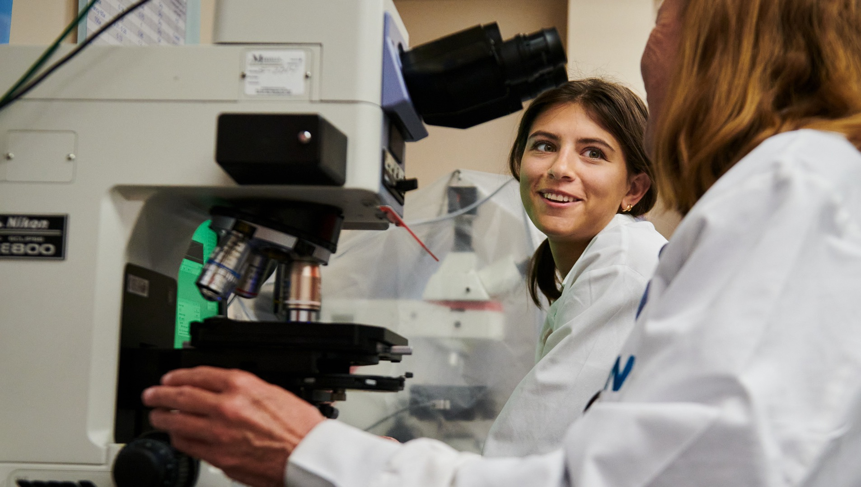
Norm Asbjornson College of Engineering supports women pursuing engineering as a career
Women students: 255% increase in 15 years to 660 women students (Fall 2022)
Women faculty: 27% of total 22 tenure-track female faculty (Fall 2022)
Norm Asbjornson College of Engineering

Slide 28

Asbjornson College's Clem Izurieta receives
$4.47 million award for cybersecurity research
Norm Asbjornson
College of Engineering
Notes:
Building on nearly five years of helping the Department of Defense and the Department of Homeland Security improve methods for resisting cyberattacks, Montana State University is leading a new effort to reduce software vulnerabilities across a wide range of systems.
The project, funded by a $4.47 million, three-year DHS contract award, will draw on advanced computing and data science techniques to develop innovative tools for identifying computer code that could be exploited by cybercriminals or foreign enemies.
The team, which includes a total of eight faculty at MSU, Idaho State University, Washington State University and Rochester Institute of Technology, will create computer models that can analyze software throughout the development process, a process known as quality assurance, and identify code that could be hacked once the software is used.

Slide 29



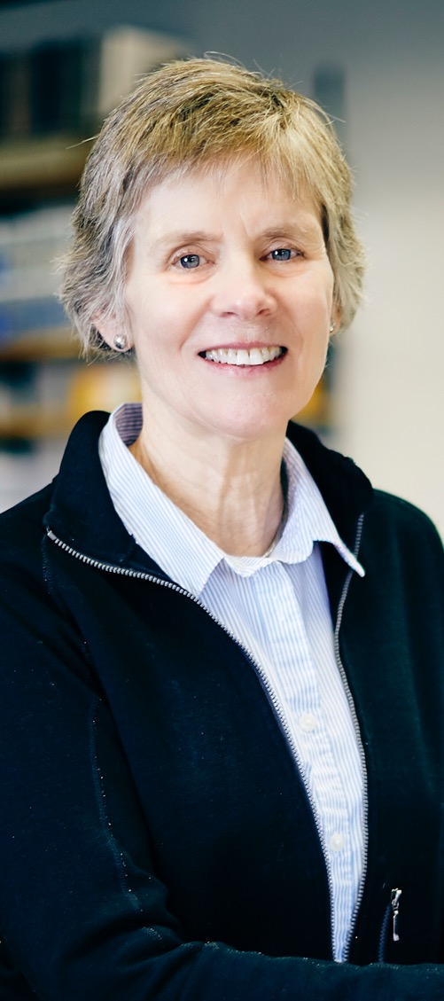
College of Letters & Science Faculty
Elected to National Academies
Joan Broderick, Dana Longcope, Elizabeth Shanahan and Cathy Whitlock
College of Letters
& Science
Notes:
Six MSU faculty members have been appointed to a national academy. They are Elizabeth Shanahan, political science professor and associate vice president for Research Development, National Academy of Public Administration; Dana Longcope, professor in the Department of Physics, National Academy of Sciences; professor Joan Broderick, head of the Department of Chemistry and Biochemistry, National Academy of Sciences and the American Academy of Arts and Sciences; retired Regents Professor Cathy Whitlock, Department of Earth Sciences, National Academy of Sciences; Alexandra Adams, faculty member in the Department of Sociology and Anthropology and director of the Center for American Indian and Rural Health Equity, National Academy of Medicine; and Peter Buerhaus, retired professor in the Mark and Robyn Jones College of Nursing, who sits on the Committee on the Future of Nursing 2020-2030 of the National Academies of Sciences, Engineering and Medicine.

Slide 30
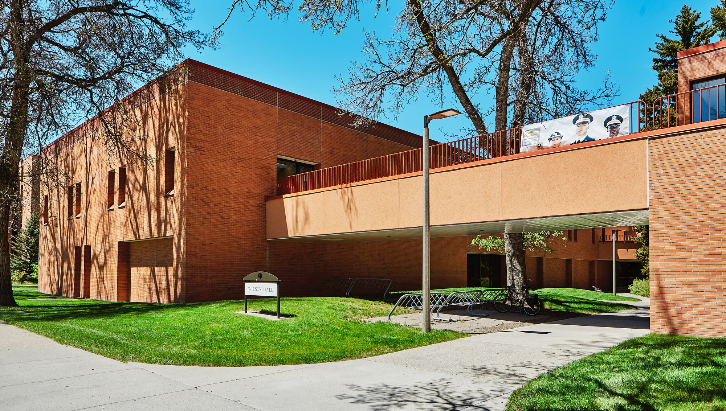
The College of Letters and Science is MSU's
'essential college'
The university's largest and most academically diverse college encompasses 13 departments and 7 interdisciplinary programs
100% of undergraduate students take CLS core classes in pursuit of their degrees
College of Letters
& Science

Slide 31
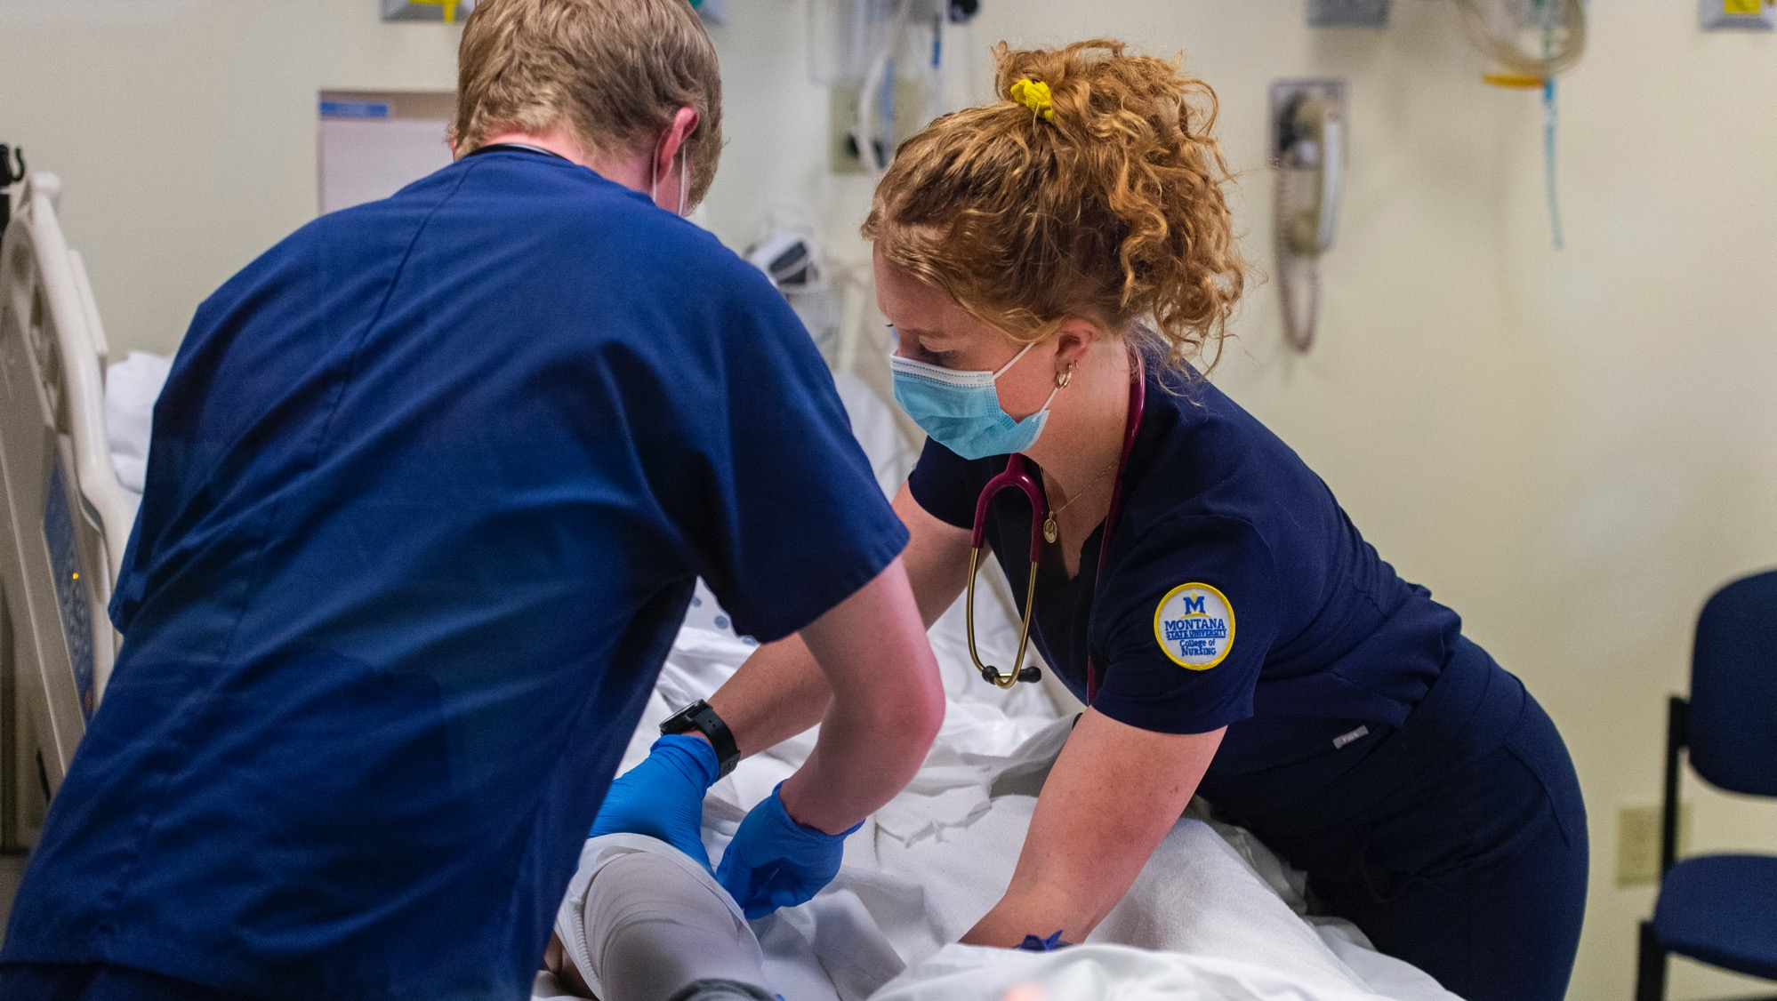
Montana State Nursing Direct Entry
Program guarantees admission for Montana high school graduates
Mark and Robyn Jones College of Nursing
Notes:
The Mark & Robyn Jones College of Nursing has implemented a new program which guarantees admission to the nursing major for every Montana high school graduate who wants to become a nurse and who comes to MSU as a freshman, maintains a 3.0 GPA and gets a C- or better in all required pre-requisite courses.

Slide 32
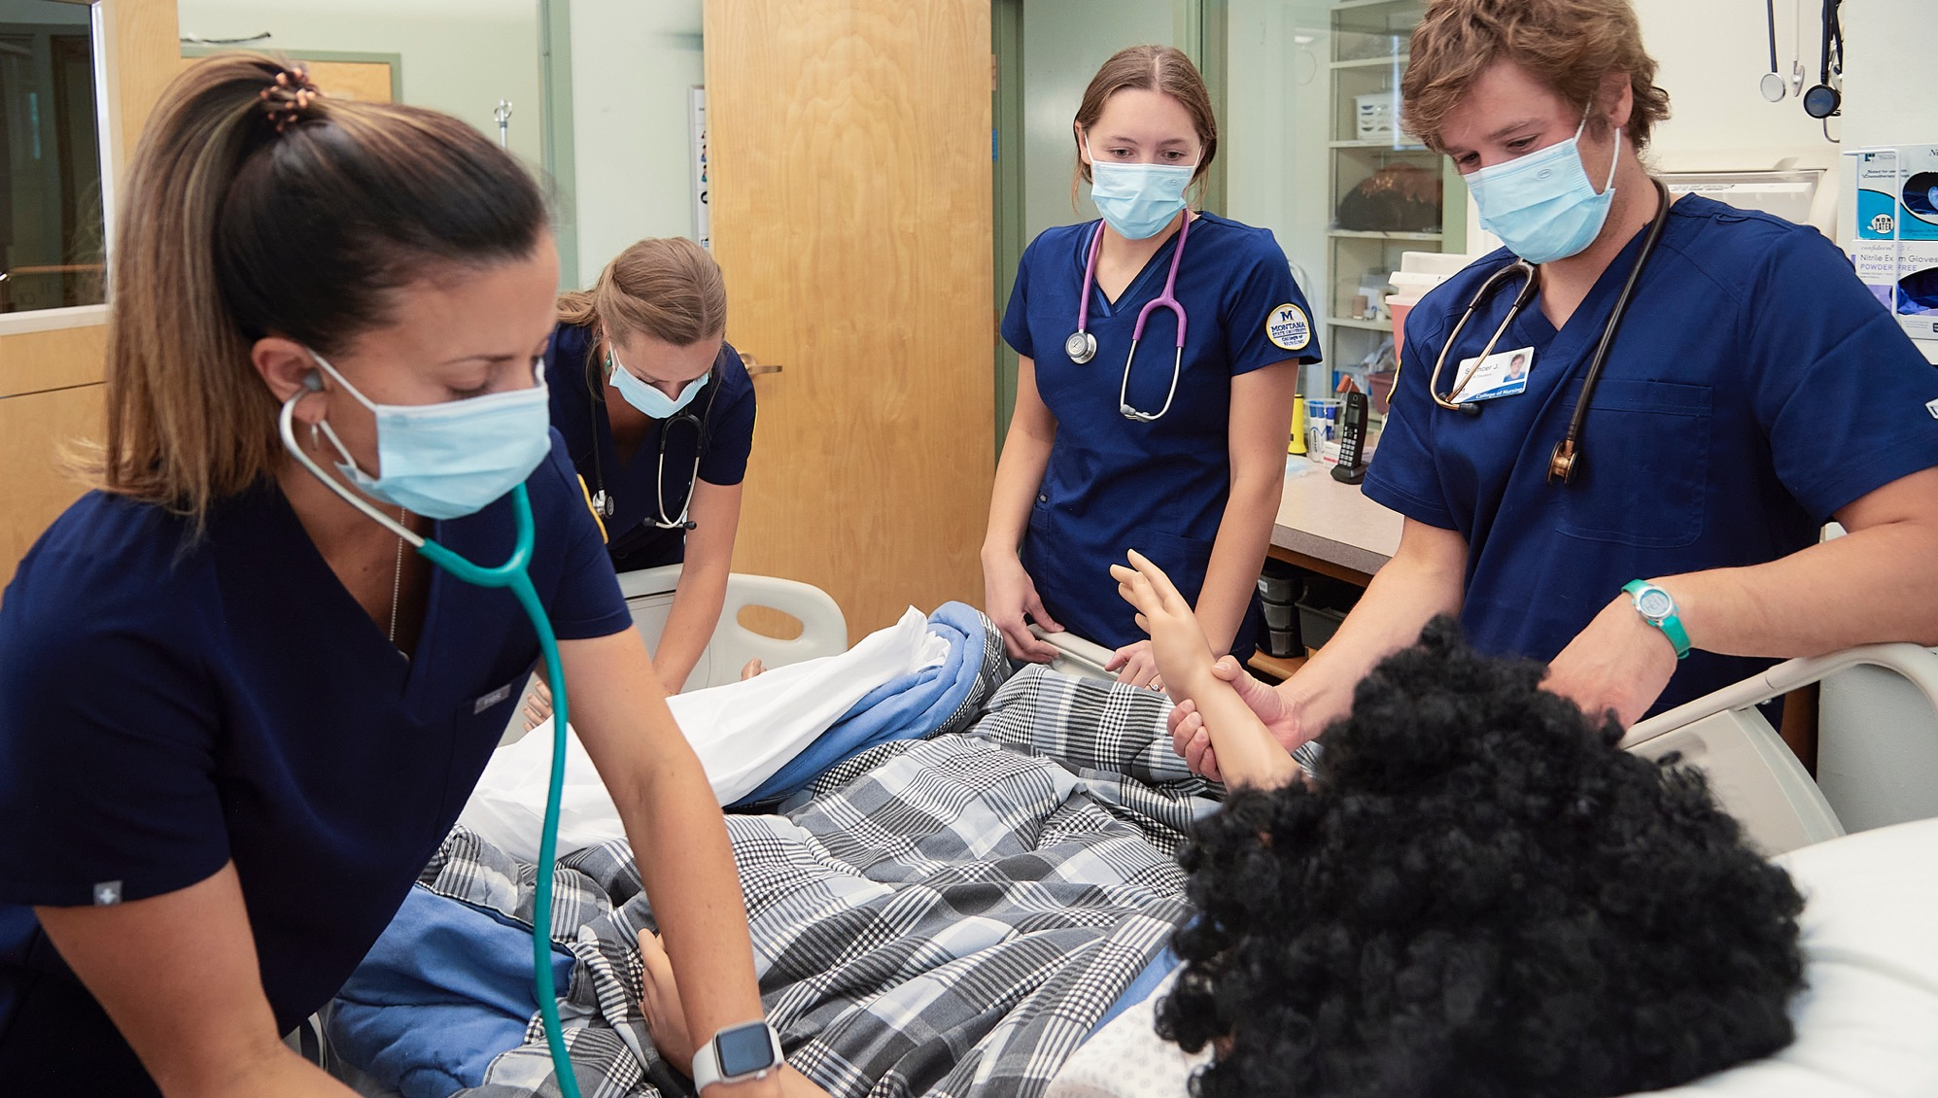
Nursing receives $2.6 million to combat lack of health care providers in rural communities
Mark & Robyn Jones
College of Nursing
Notes:
The ANEW program is funded by a grant from the Health Resources and Services Administration, a division of the U.S. Department of Health and Human Services. MSU received its first ANEW grant in 2019, and it was recently renewed for $2.6 million over four years, which administrators in the Mark and Robyn Jones College of Nursing refer to as ANEW 2.0. It allows the nursing college to provide the financial support to cover tuition and fees, books and supplies, and travel for students. The ANEW program is designed to increase access to health care for rural Montanans, a core focus of the nursing college. All but two of Montana’s 56 counties are classified as health care professional shortage areas, according to the state’s Department of Health and Human Services.

Slide 33
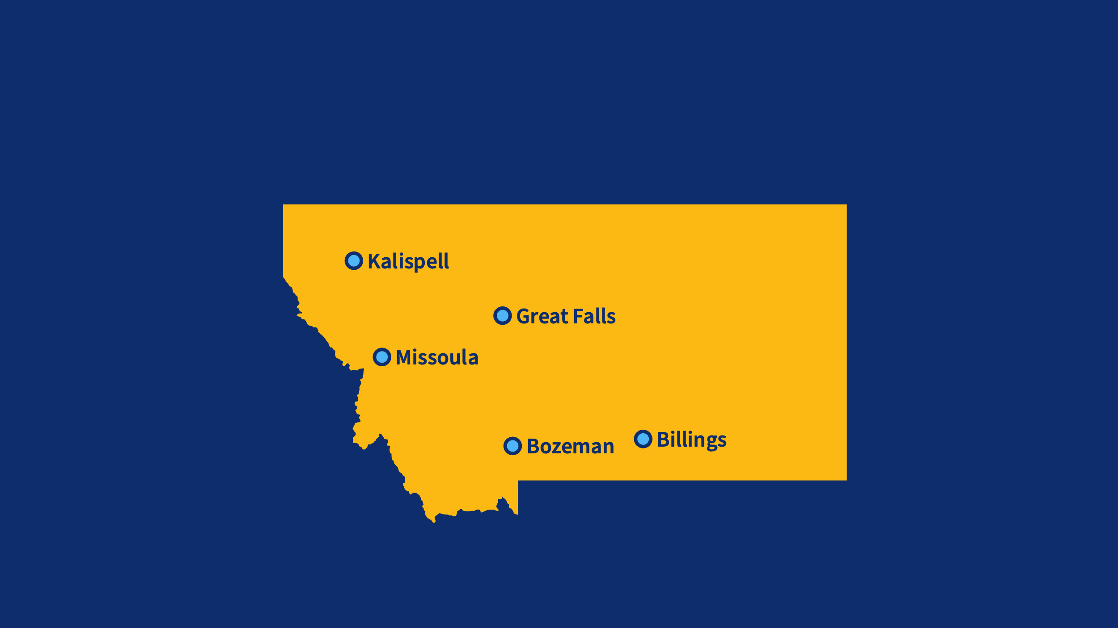






MSU Mark & Robyn Jones College of Nursing:
State-of-the-art nursing education for Montana
Notes:
So far, MSU has partnered with Benefit Health System in Great Falls, St. Vincent and Billings Clinic in Billings, and Logan Health in Kalispell to establish locations for the new nursing education buildings. This will be the first time that MSU’s Mark and Robyn Jones College of Nursing has had its own, dedicated spaces for nursing teaching in these cities. The new buildings, when constructed, will provide our students with state-of-the-art technology and simulation labs that will train them thoroughly to provide the state and its citizens with the health care so urgently needed in so many of our rural and frontier communities.

Slide 34

Gallatin College MSU
Fastest-growing college at Montana State University with enrollment up by 21% with 22 certificates and Associate of Applied Science and Associates degrees
Gallatin College MSU

Slide 35

Unique programs include Photonics and Optics, Avionics, HVAC-R and Cybersecurity
Gallatin College MSU

Slide 36
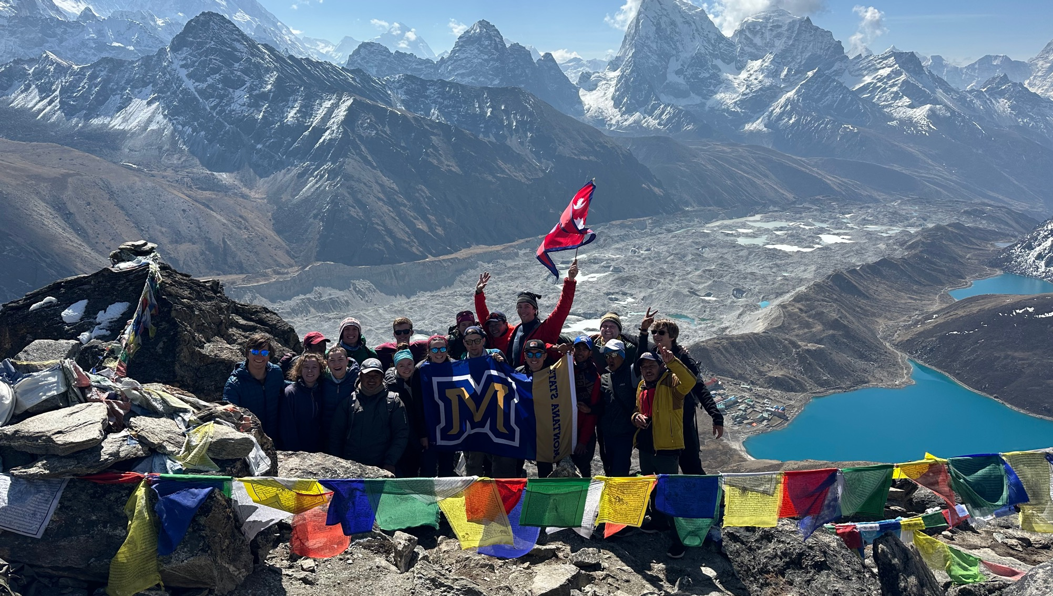
Montana State students take international experience to Nepal for Honors College 'Great Expeditions' course
MSU Honors College
Notes:
Fifteen students who traveled to Nepal in May as part of a course called Great Expeditions. An annual offering in MSU’s Honors College, the course provides students with international experiences after spending a semester in preparation and research.

Slide 37




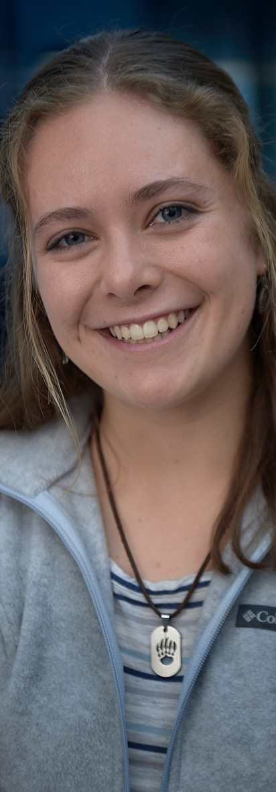
Honors College National Scholarship Recipients
2 Goldwater, 3 Fulbright, 1 Truman, 11 NSF Graduate Research Fellowships
16 finalists for Rhodes, Gates Cambridge, Marshall and Udall Scholarships
MSU Honors College
Notes:
Montana State is among the top schools in the nation for major scholarship awards.

Slide 38

MSU Police Department earns International Association of Campus Law Enforcement Administrators accreditation
News
Notes:
The Montana State University Police Department has become the first law enforcement agency in the state of Montana to be accredited by a third-party verifying agency. The International Association of Campus Law Enforcement Administrators, the largest global professional association devoted to excellence in campus public safety and law enforcement, recently confirmed MSU’s compliance with core and elective categories for official accreditation. Accreditation is a voluntary, self‐regulatory process that helps assure a university’s public safety, including policy and procedures, management, operation and support services, Stanley said. To be accredited, UPD must comply with 227 standards and submit annual reports attesting to the department’s continued compliance. The department will go through reaccreditation every four years.

Slide 39

Year of the Bobcat

Slide 40
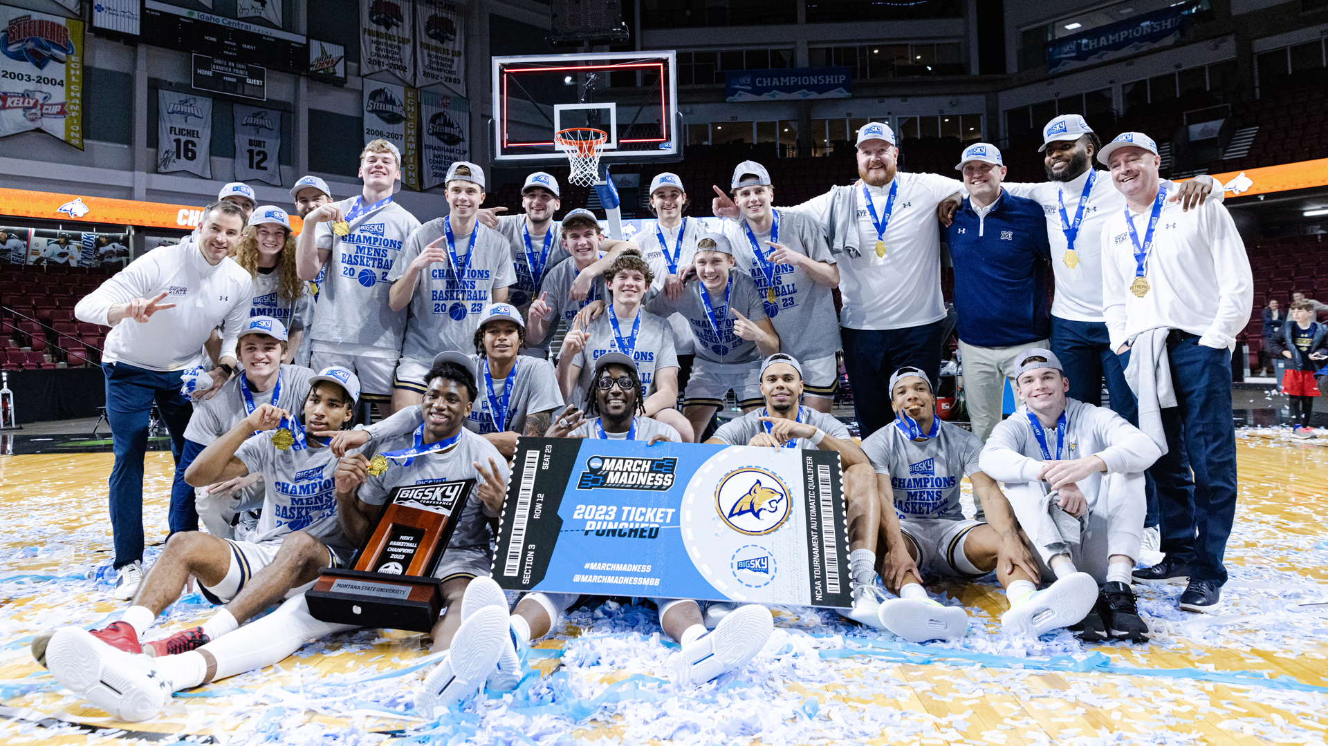
Bobcats return to the NCAA Tournament with Big Sky Championship Victory
Sports
Notes:
For the first time in program history, the MSU men's basketball team advanced to a second-straight NCAA tournament in 2023.

Slide 41
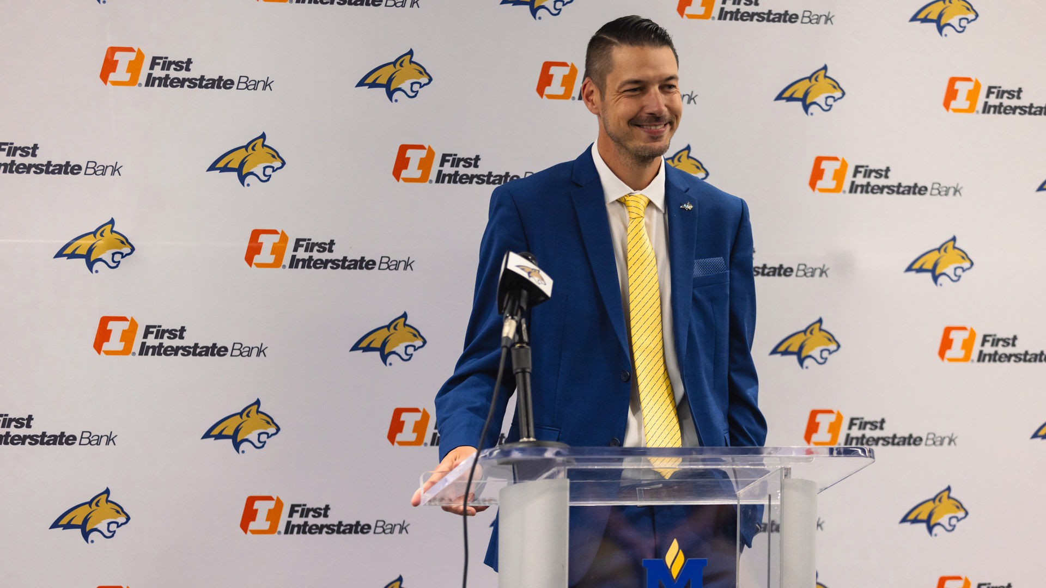
Matt Logie Named Montana State Men's Head Basketball Coach
Sports
Notes:
Matt Logie, a coach with championship pedigree rooted in the Northwest, was named Montana State's head men's basketball coach in April 2023. Logie came to Montana State after four seasons at Point Loma in California, where his teams rolled up an 82-23 record with three conference championships. His 12 seasons as a head basketball coach includes eight at Whitworth University in Spokane (2011-19). His Pirates compiled a 194-35 record, and his 276-58 career mark in 12 seasons is good for an .826 winning percentage, third-best among active coaches at four-year schools.

Slide 42
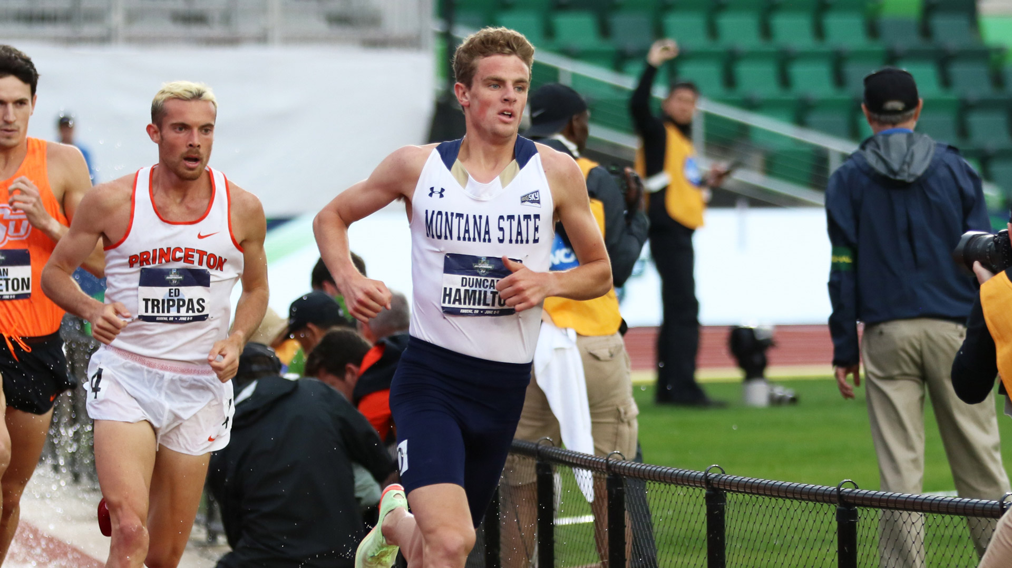
Duncan Hamilton named to 2023 Bowerman Watch List for outstanding NCAA track and field athletes
Sports
Notes:
Montana State track standout Duncan Hamilton is the first Bobcat ever named to The Bowerman Watch List, the sports equivalent to the Heisman award. The Bowerman's given each year to the most outstanding male and female NCAA track and field athletes. Hamilton was one of 10 men named to the final list of the season in June 2023.

Slide 43
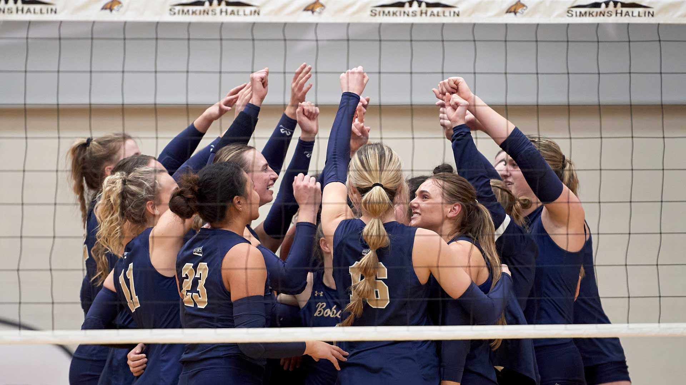
MSU Women’s volleyball team plays for its first ever Big Sky Conference title
Sports
Notes:
This marks the first time the Bobcats have played in a Big Sky Conference tournament championship match in the 36-year history of the league. Women's sports started play in the Big Sky Conference in the fall of 1988.

Slide 44

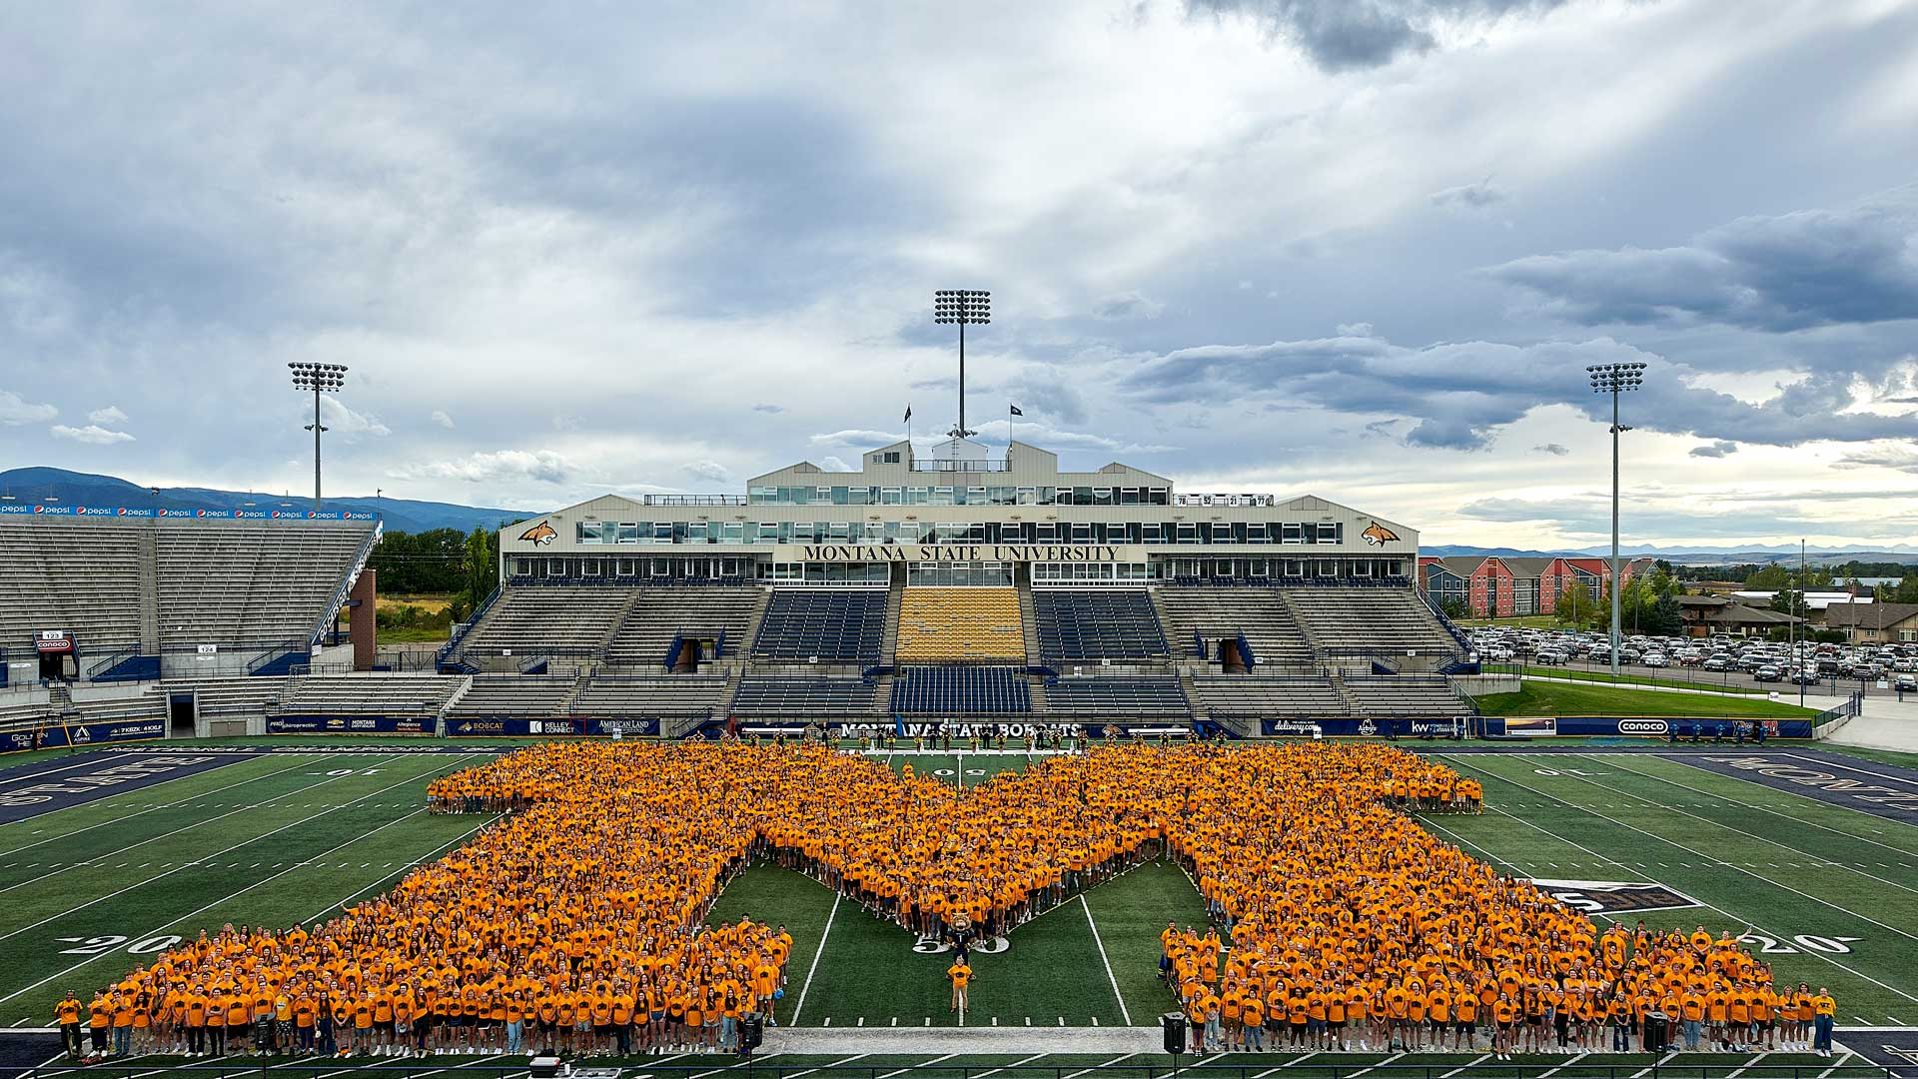
M photo
Notes:
On Aug. 22, 2023, MSU gathered its incoming first-year students in Bobcat Stadium for the traditional M Photo.

Slide 45
End slide

