Slide 1
Office of Graduate Student Success
Our office supports graduate students from the approval of their Programs of Study to the acceptance of their graduation applications and theses/dissertations.
Most current student questions come to us—though online students typically have close relationships with their department and often begin there.
Can be reached at degreesandcertificates@montana.edu for questions.

Slide 2
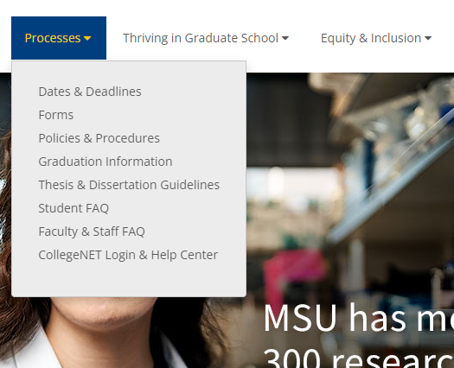
Grad School’s homepage
“Processes” drop-down
On the Graduate School website, the Current Students dropdown menu will often be your starting point for questions
Highlights: dates and deadlines specific to graduate students, forms, FAQs, and thesis/dissertation information

Slide 3
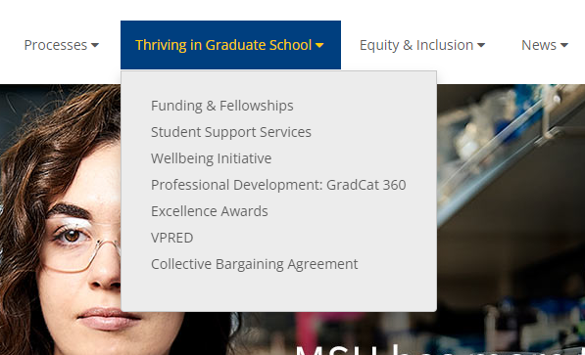
Grad School’s homepage
Thriving in Graduate School drop-down
Professional development, funding resources, and student support resources are all found here
Note there are programs for food assistance, childcare assistance, and other wellbeing resources

Slide 4
Program of Study & Committee forms/processes
Your Graduate Committee helps guide your graduate education. A committee is not always required—see your department for details. You can submit your committee in MyInfo and this must be done before the program of study
The Program of Study outlines the requirements for your degree (including certificate-seeking programs). This process is also in MyInfo
The deadlines for a program of study are: first term of attendance for certificate, second term for master’s, and third term for doctoral degrees
You can revise your program of study and committee

Slide 5
DegreeWorks
DegreeWorks is the advising software at MSU
Keep track of your degree requirements with DegreeWorks, found through MyInfo
Before you complete your Program of Study, the degree requirements will be generic, listing general requirements for your major
After you fill out the Program of Study form, DegreeWorks will show your customized list of classes

Slide 6
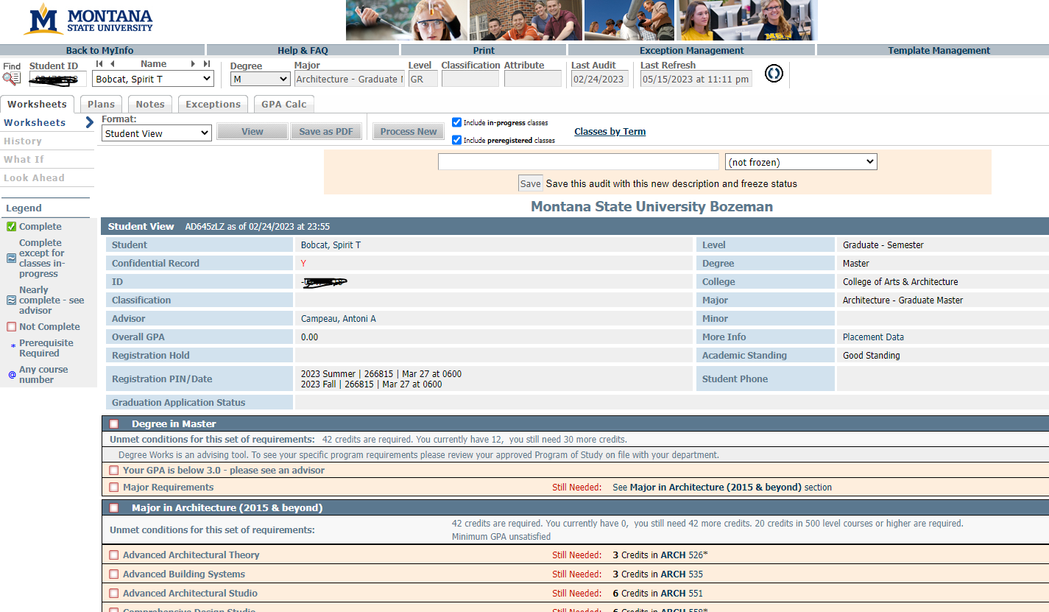
DegreeWorks example

